Slide 1
Theme 4 - Lesson 4
TRAVEL
Welcome to my class!

Slide 2
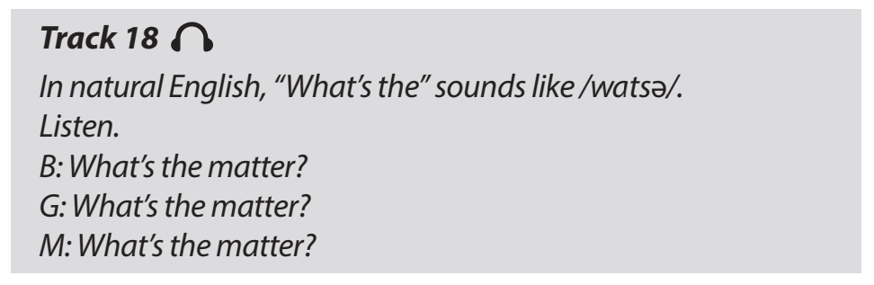
PRONUNCIATION TIP

Slide 3
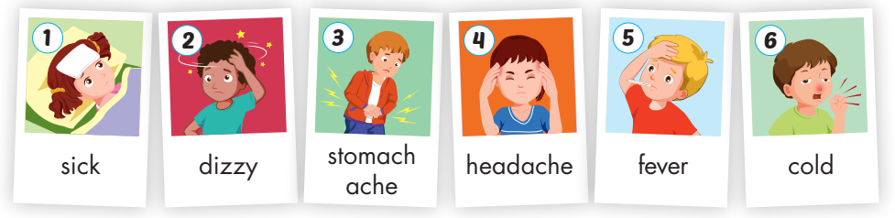
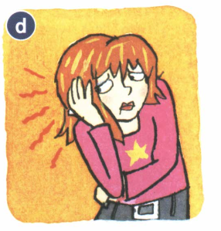
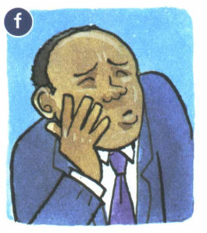
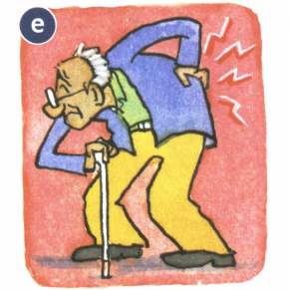
BINGO. Write 3 words
earache
toothache
backache

Slide 4
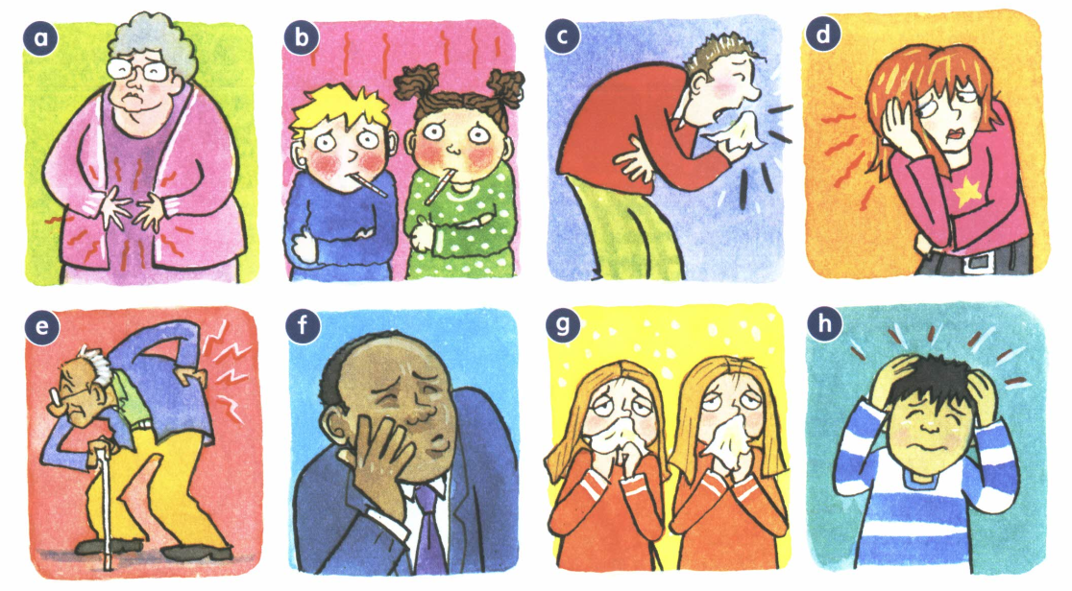
VOCABULARY REVIEW

Slide 5
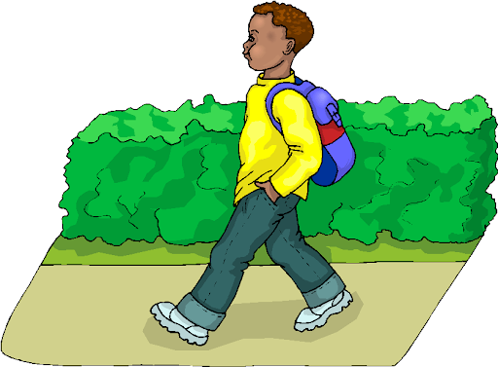
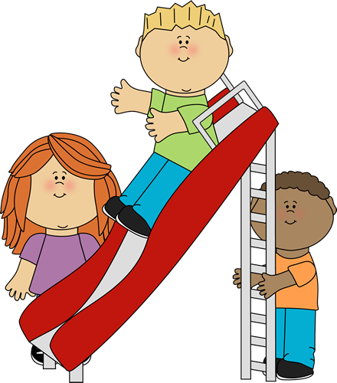
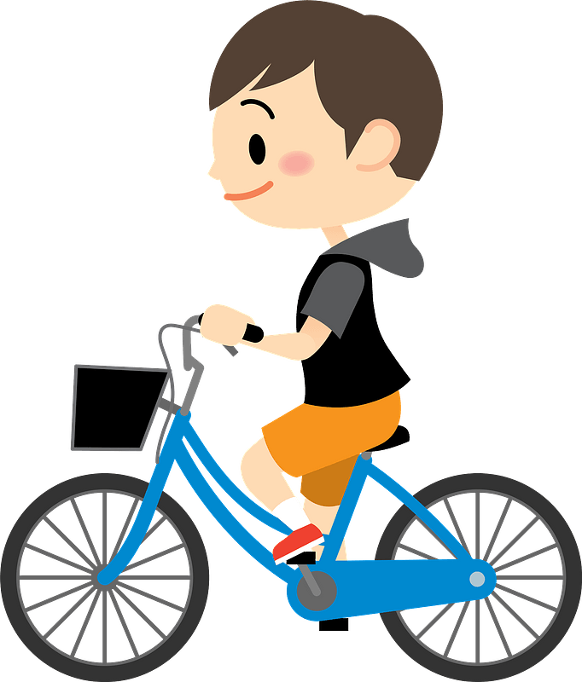
Write the past form of these verbs
1
____________________
1
____________________
3
____________________

Slide 6
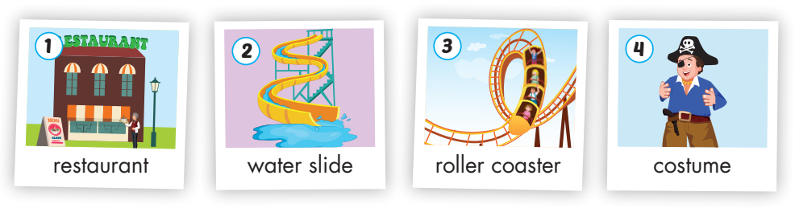
Vocabulary

Slide 7
Look and match the picture to the word
water slide
restaurant
pirate
roller coaster

Slide 8
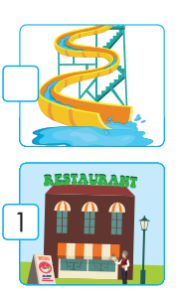
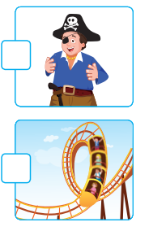
Listen and write number to the places

Slide 9
Grammar structure
What did you do?
Secondly, S + V2 (ed)
01
02
03
Firstly, S + V2 (ed)
Finally, S + V2 (ed)

Slide 10
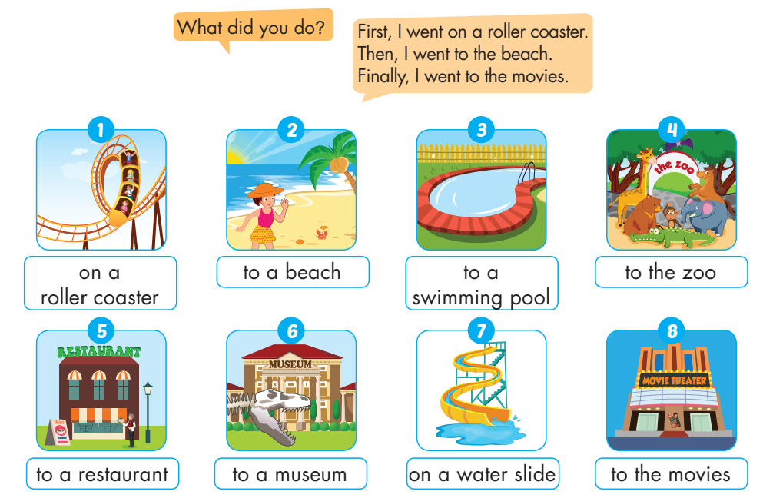
Listen and write the number

Slide 11
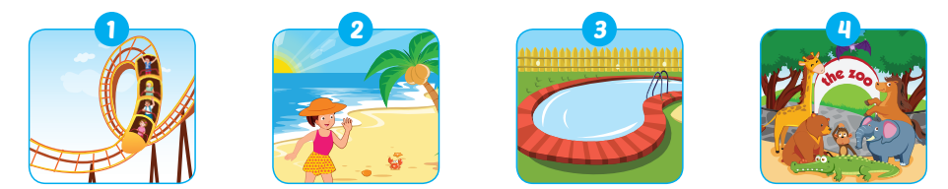
Look and say the activity in the past
ride on a roller coaster
went on a roller coaster
go to a beach
________________________
go to a swimming pool
________________________
go to the zoo
________________________

Slide 12
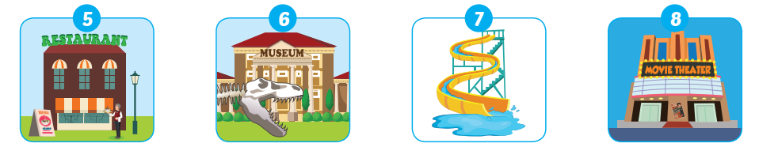
Look and say the activity in the past
go to a restaurant
________________________
go to a museum
________________________
go to a water slide
________________________
go to the cinema
________________________

Slide 13
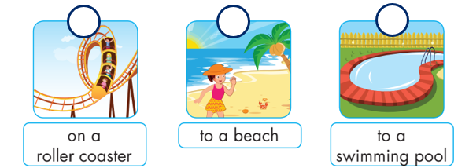
Choose three places and number them
Then tell your friend what you did.

Slide 14
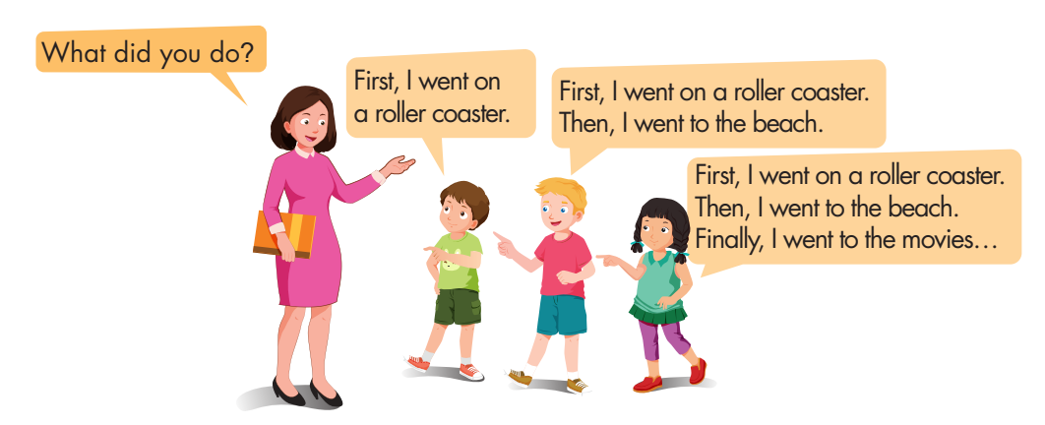
Memory chain

Slide 15
Thank you
& good bye!

Slide 16
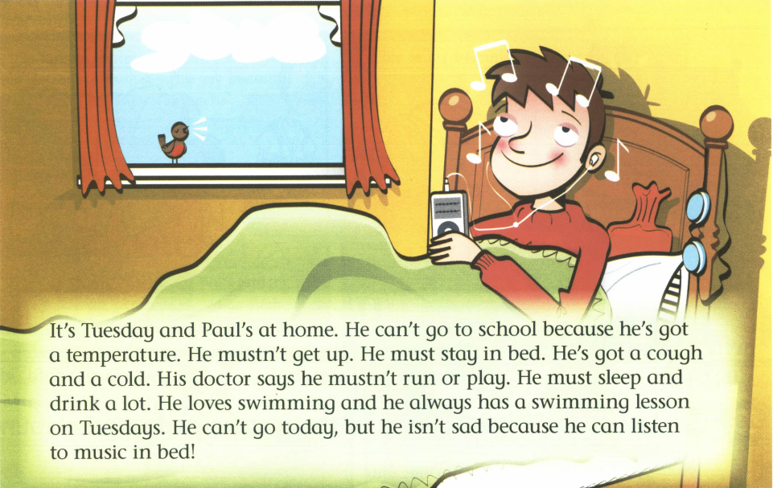
Read AND CORRECT SENTENCES
Paul’s at school.
Paul mustn’t stay in bed.
He has a fever.
He must get up.
His doctor says he mustn’t run.
He mustn’t sleep.
He always has a piano lesson on Tuesdays.
It's Tuesday and Paul's at home. He can't go to school because he's got a temperature. He mustn't get up. He must stay in bed. He has a cough and a cold. His doctor says he mustn't run or play. He must sleep and drink a lot. He loves swimming and he always has a swimming lesson on Tuesdays. He can't go today, but he isn't sad because he can listen to music in bed!

Slide 17
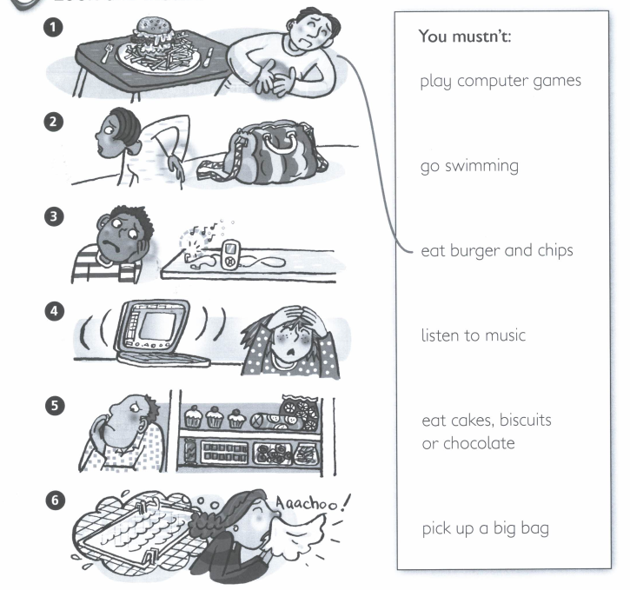
Look and match. Then write advice
When you have a stomach ache, you mustn’t eat burger and chips.
When you have a ______________________, ___________________________________________.
When you have a ______________________, ___________________________________________.
When you have a ______________________, ___________________________________________.
When you have a ______________________, ___________________________________________.
When you have a ______________________, ___________________________________________.

Slide 18

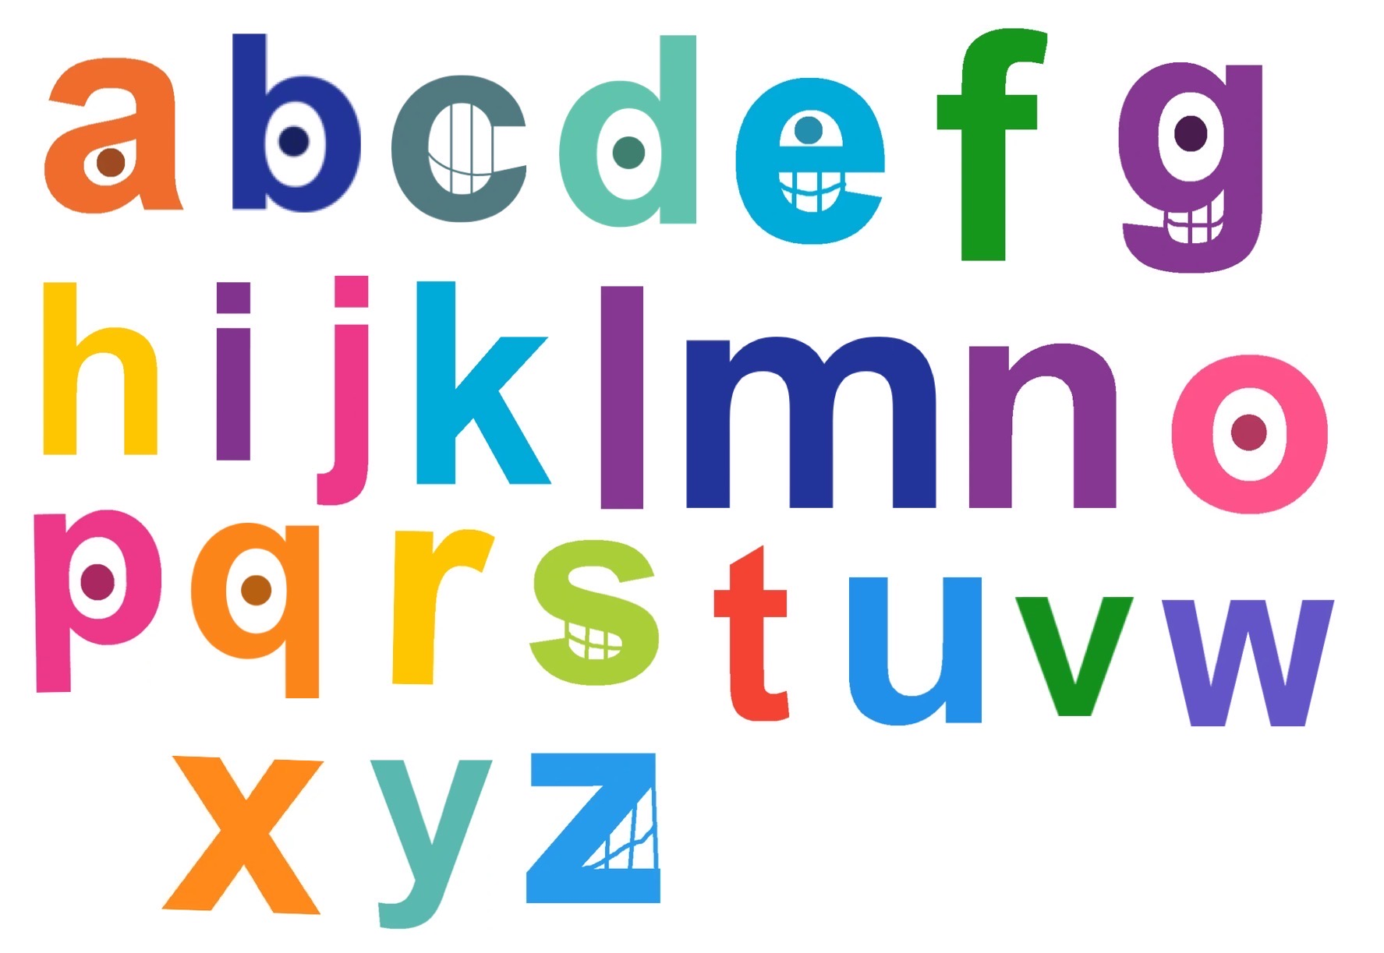
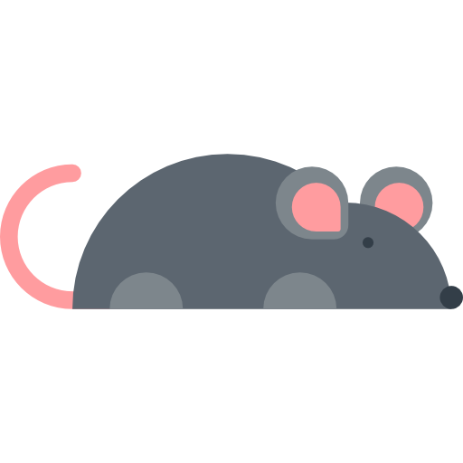
Mouse and Cheese | Guessing game

Slide 19
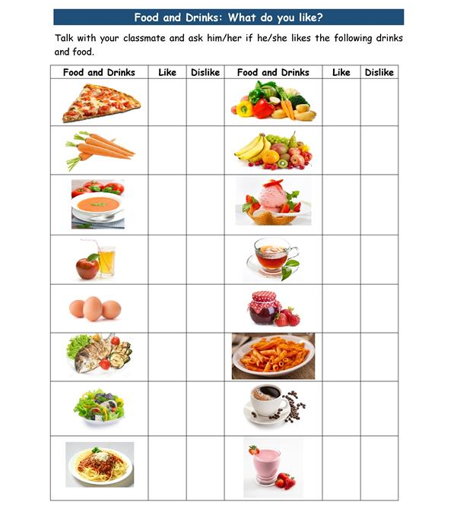


Do you like eating/drinking …?
Yes, I do.
No, I don’t.
Report
- Name likes eating …
- Name likes drinking…
- Name doesn’t like eating …
- Name doesn’t like drinking…

Slide 32
UPCOMING EVENTS
Mercury is the closest planet to the Sun
Jupiter is a gas giant and the biggest planet
01
02
03
04
It’s the farthest planet from the Sun
Venus is the second planet from the Sun

Slide 33
REVIEW OF PAST EVENTS
Mars
01.
Despite being red, Mars is actually a very cold place
Mercury
02.
Mercury is the closest planet to the Sun and the smallest one
jupiter
Jupiter is a gas giant and the biggest planet in the Solar System
03.

Slide 36
ALTERNATIVE RESOURCES

Slide 37
RESOURCES
Did you like the resources on this template? Get them for free at our other websites:
Photos
◂ Person putting a stethoscope on a piggy bank
◂ Finance elements with white piggy bank
Icons
◂ Doodle big data background
◂ Doodle facebook ads background
Vectors
◂ Colorful doodle animals and words pattern
◂ Colorful doodle animals and words pattern

